Slide 1


Principal Component Analysis
Angela Diamidia

Slide 2
What is the principal component analysis?
The principal component analysis (PCA) is a technique for reducing the dimensionality of large datasets that are sometimes difficult to interpret. It helps with interpretability by reducing the number of variables of a data set and preserving important information. For example,
from a 100-Dimensional to a 2-Dimensional.

Slide 3
How to find the Principal components?
A total of Five steps was used for my analysis.
Generating dataset: a dataset with 2 variables and 24 observations.
Normalization : this step aims to subtract the mean of x and y from all the values of x and y.
Computing the covariance matrix: the goal is to check if a correlation between the two variables x and y exist; this is done by taking the covariance between two data points x and y.
Finding the principal components : In this step eigenvectors and corresponding eigenvalues would be computed from the covariance matrix and will be sorted in descending order. The eigenvalues with the highest value are the principal components
Getting the Final dataset: This step is about obtaining the data with the reduce dimension. This step is done by multiplying the principal component by the adjusted data found in the second step.

Slide 4
MATLAB code

Slide 5
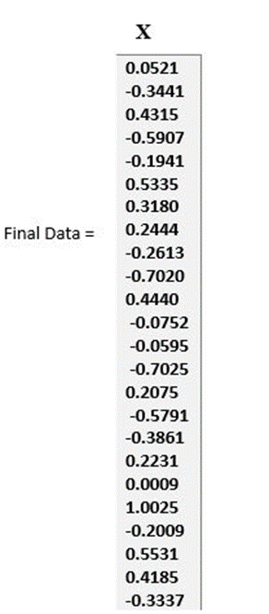
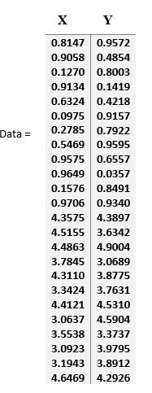
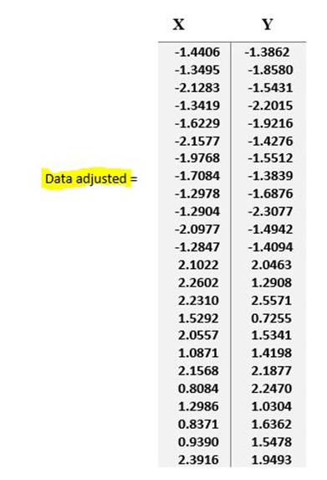
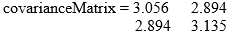
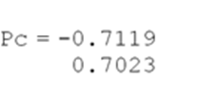
MATLAB Results

Slide 6
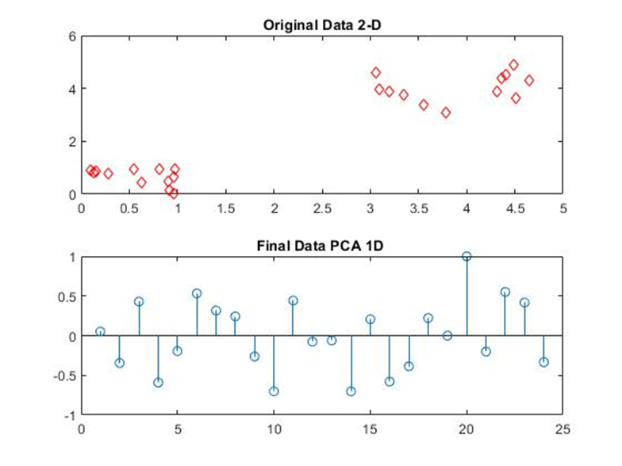
Illustration

Slide 7
Notes on PCA and SVD
There exists a relationship between the Singular Value decomposition (SVD) and the PCA.
1.Generating dataset
2.Normalization
3.Computing the covariance matrix
4. Compute SVD (Finding the principal components )

Slide 8
Sources
Lindsay I Smith (2002). Retrieved from http://www.cs.otago.ac.nz/cosc453/student_tutorials/principal_components.pdf
Maskara, V. (2020, June 22). Principal Component Analysis in MATLAB. Retrieved November 17, 2020, from https://medium.com/analytics-vidhya/principal-component-analysis-in-matlab-f5c27b76e8c
Dubey, A. (2018). Toward data science [Web log post]. Retrieved from https://towardsdatascience.com/the-mathematics-behind-principal-component-analysis-fff2d7f4b643
Jaadi, Z. (n.d.). A Step by Step Explanation of Principal Component Analysis. Retrieved November 17, 2020, from https://builtin.com/data-science/step-step-explanation-principal-component-analysis
Z, Wang. PCA and SVD explained with NumPy. Retrieved March 16, 2019, from https://towardsdatascience.com/pca-and-svd-explained-with-numpy-5d13b0d2a4d8

